Slide 1
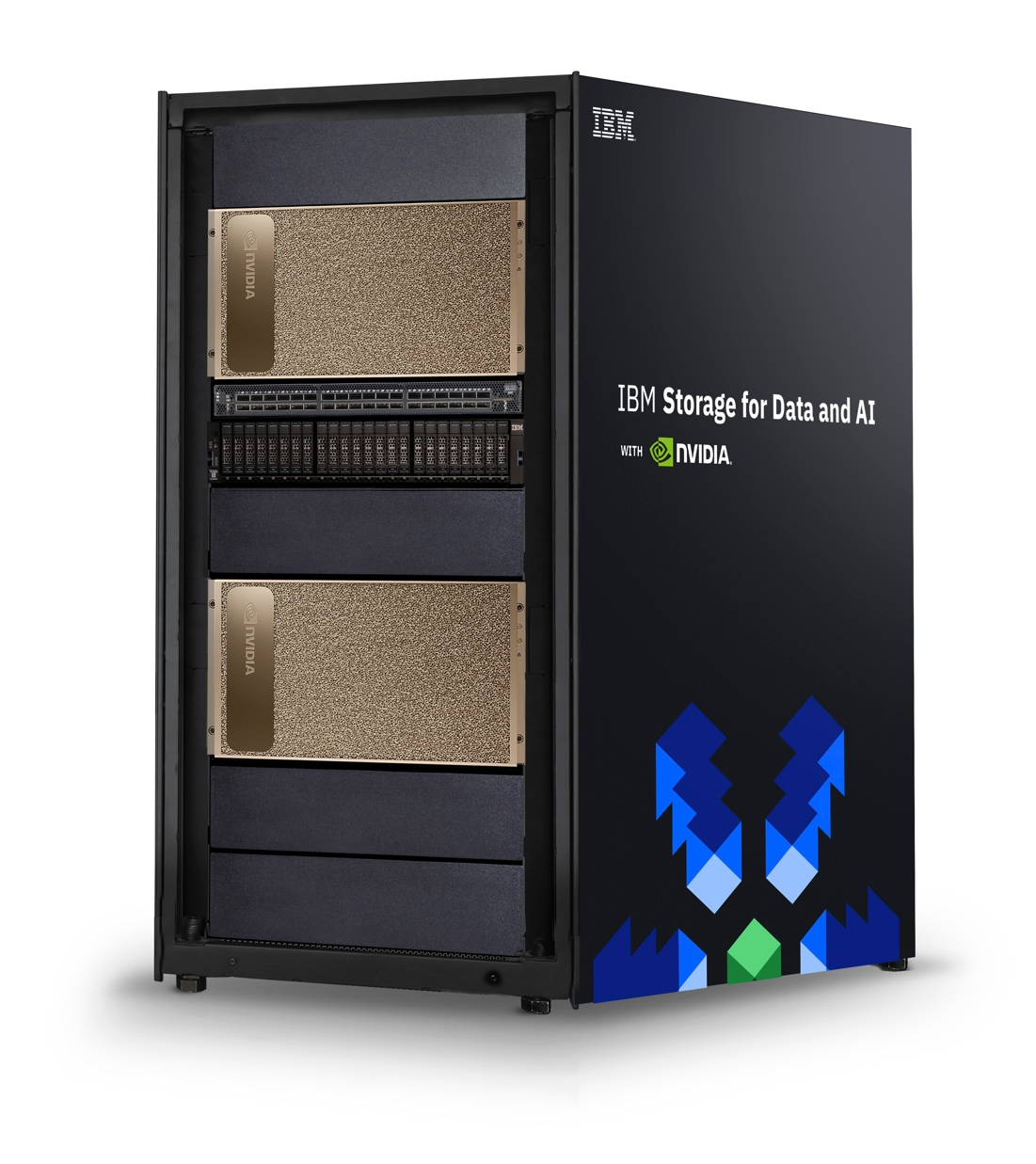
Scaling AI with IBM Storage and NVIDIA DGX
—
Douglas O’Flaherty
Global Ecosystem Leader, IBM Storage douglasof@us.ibm.com
Notes:
The adoption of GPU-accelerated computing infrastructure has become imperative to support deep learning (DL) and other computationally intensive workloads. GPUs enable working with large data sets and real-time streaming that is not possible on other platforms. However, accelerated computing needs to be matched with storage and networking that is also capable of large, diverse, and real-time data management.
This presentation discusses scaling client’s AI infrastructures with IBM Storge and NVIDIA DGX.

Slide 2
STORAGE MATTERS
the fastest servers in the world are the world’s
slowest servers if they are waiting for data
ALL GPUs & CPUs WAIT AT THE SAME SPEED
FastGPU
Notes:
Don’t let storage be the weakest link in the data environment. A client’s latest and greatest servers are only as fast as the data streams that the storage systems can provide. This is an often-overlooked law of physics — especially in AI domains where there has been tremendous focus on graphical processing unit (GPU) acceleration. Accelerated servers are critical to any data-driven transformation (and IBM Systems has the best offers here), but so is storage.
What type of storage systems should be used to support AI analytics deployments?

Slide 3
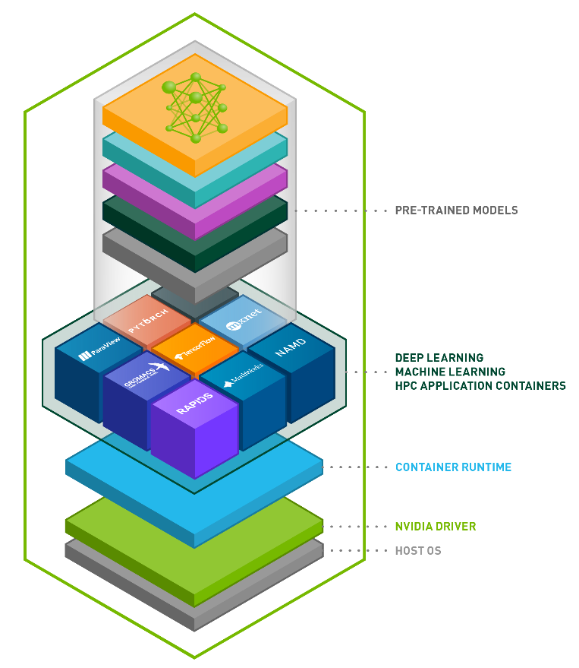
NVIDIA DGX A100 POD RA
2/4/8 Node Scaling
January 2021
NVIDIA DGX A-100 Server
8x NVIDIA Tensor Core GPUs
5 petaFLOPS in a single system
10x NVIDIA® Mellanox® ConnectX-6;
200 Gb/s HDR InfiniBand or Ethernet
Starting price $199,000
IBM ESS 3000
IBM Spectrum Scale v5
All-Flash NVMe solution
12x 100 Gb/s EDR InfiniBand or Ethernet
42 GB/s read; 32 GB/s write minimums
NVIDIA Mellanox QM8700 Switch
40 port
200 Gb/s HDR InfiniBand or Ethernet
NVIDIA Cuda-X Software Stack
Open source
Container support
Developers use NVIDIA CUDA libraries for GPU
NVIDIA NGC: Container libraries available
OS is based on Ubuntu
Notes:
IBM Storage has published a reference architecture with the latest DGXA100 systems (https://www.ibm.com/downloads/cas/MJLMALGL).
The architecture has been tested with a single system and then with two, four, and eight node configurations to demonstrate scalable performance and the simplicity that IBM can bring customers for a scaled AI Information Architecture (IA).
IBM’s solution can help to meet the needs of the key stakeholders:
The data scientist: “I need something fast and simple to deploy now.”
The IT manager: “We need something that can be simple to manage and grow cost effectively with.”
The risk management team: ”We need data governance and backup for all data for decades to come.”
The line of business (LOB) executive: “We need to go into production globally and adhere to all regulations and SLAs.”
Notes:
GPU = Graphics processing unit
GB/s = Gigabytes per second
Gb/s = Gigabits per second
HDR = High Dynamic Range
EDR = Extended Data Rate
NVMe = Non-volatile memory express
SLA = Service-level agreement

Slide 4
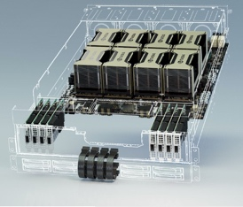

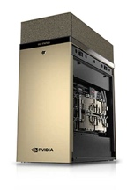
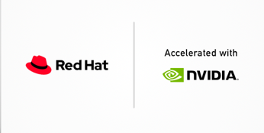
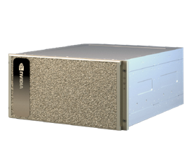
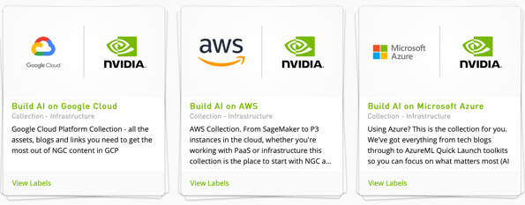
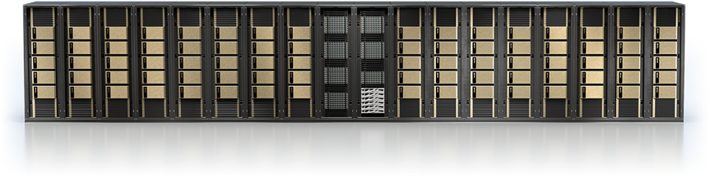
IBM Storage related NVIDIA A100 GPU solutions
NVIDIA HGX A100
OEM platform
4x, 8x, & 16x NVIDIA GPU configurations
Offered by almost all vendors, including
HPE, ATOS, Lenovo, SuperMicro
Full AI workflow
Full AI data pipeline workflow
with NVIDIA DGX blueprint
IBM Cloud
Object Storage
IBM Spectrum Discover
IBM Spectrum Scale
NVIDIA DGX A100 Workstation
“Office ready”
4x NVIDIA GPUs for 2.5 petaFLOPS
Up to 7.68 TB NVMe data storage
2x 100 Gigabit ethernet
Red Hat and OpenShift
Fully supported and documented
NVIDIA DGX A100 Server
“Universal System for all AI workloads”
8x NVIDIA A100 80 GB GPUs for 5 petaFLOPS
Multiple IB and ethernet connectivity options
Available alone or in 2, 4, and 8 node PODs
NVIDIA DGX A100 SuperPOD
Reference architecture for large scale installations
Based on Celene, the NVIDIA Supercomputer built in 2020
NVIDIA GPUs in the Cloud
AWS, Azure, and Google
Notes:
NVIDIA builds great graphics processing units (GPUs) in many form factors to help customers satisfy compute requirements from edge to core. And NVDIA has tremendous software and high-speed networking to allow their customers to deploy what they need and grow it.
The third pillar of infrastructure is data management. This is where IBM helps to complete the NVIDIA value proposition by offering customers a lot of complementary capabilities.
IBM has a portfolio that can offer full AI workflow and data management across the entire spectrum. For collection or ingest of data, IBM offers Spectrum Scale or IBM Cloud Object Storage (COS) capabilities. More importantly, IBM has Spectrum Discover that helps customers with scalable tagging that can be used for governance, resource optimization, and time savings at the data preparation stage. Spectrum Scale is available to help customers with performance intensive training and inference stages of AI, and IBM has put together a full workflow blueprint for this. Customers are facing challenges at the workflow level. And this is where IBM can help them build something that works for them and that will scale.
More recently, IBM has teamed with NVIDIA on a technical paper that focusses on AI with containers. Most customers don’t have a lot of experience with containers in production and this paper was cited as a tool by an NVIDIA Solution Architect as something that can save a customer up to 9 months. The most recent version of IBM Spectrum Scale is fully containerized and enhances IBM’s hybrid cloud capabilities to give customers more speed and agility.
Spectrum Scale is also available for customers in the cloud or for hybrid cloud use cases. There is increasing interest for Spectrum Scale with GPUs for hyperscale partners like Amazon Web Services (AWS), Microsoft Azure, and Google Cloud Platform (GCP).
Notes:
OEM = Original equipment manufacturer
NVMe = Non-volatile memory express
GB = Gigabyte
TB = Terabyte

Slide 5
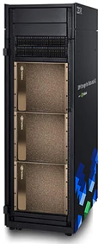
IBM Storage performance with NVIDIA DGX A100 2/4/8 node POD configurations
IBM ESS 3000 results
ESS 3000 demonstrated linear scaling
Highest performing 2/4/8 node reference architecture
Vendor | 2 x DGX A100 Read perf | 4 x DGX A100 Read perf | 8 x DGX A100 Read perf
IBM – 2x ESS 3000 | 42 GB/s | 78 GB/s | 94 GB/s
NetApp AFF A800 Pair | 18 GB/s | 25 GB/s | 45 GB/s
Pure Storage | 15 GB/s | 25 GB/s
Weka IO | 34 GB/s | 62 GB/s
EMC Isilon F800 | 10 GB/s | 19 GB/s
Typical customer recommended AI configurations
One ESS 3000 in 2U for up to four DGX A100 nodes
Two ESS 3000s in 4U for five to eight DGXA100 nodes
with 94 GB/s
Mellanox InfiniBand recommended for forward scalability
Simple upgrades with SDS for more capacity and bandwidth
Provides performance scalability, simple growth,
and enterprise features for putting AI into production
DDN
No 2/4/8 node DGX System scaling results
One DGX A100 with One AI400x
  49 GB/s read; 35 GB/s write
One DGX A100 with Two AI400x = 99 GB/s read
10 DDN AI400x in SuperPOD
  ~500 GB/s max IOR read
Notes:
This slide shows performance values. This slide is self-explanatory.
Notes:
GB/s = Gigabyte per second
SDS = Software-defined storage
Links:
IBM: https://www.nvidia.com/en-us/data-center/resources/ibm-spectrumai-reference-architecture/
DDN: https://www.nvidia.com/en-us/data-center/resources/ddn-a3i-reference-architecture/
Dell/EMC: https://www.nvidia.com/en-us/data-center/resources/dell-emc-dgx-pod-reference-architecture/
NetApp: https://www.nvidia.com/en-us/data-center/resources/netapp-ontap-ai-reference-architecture/

Slide 6
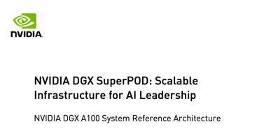
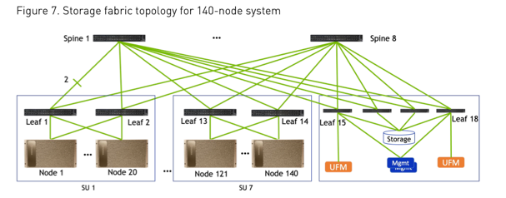
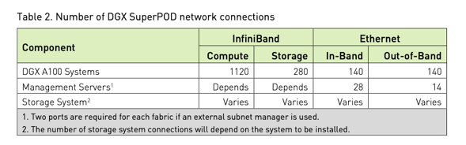
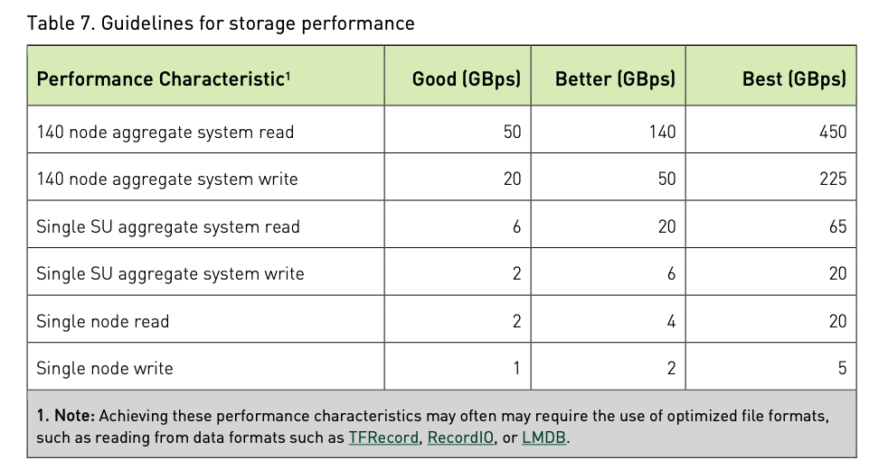
NVIDIA SuperPOD storage requirements
The NVIDIA SuperPOD RA is a guideline
Storage requirements, rack layout, and networking
It does not specify a particular storage vendor
IBM Spectrum Scale on ESS meets
all of the requirements defined in the
NVIDIA DGX A100 SuperPOD RA
Best performance can be achieved multiple ways
  10x ESS 3000 ~450 GB/s read
  10x ESS SC5 ~520 GB/s read
IBM is one of very few with the experience to tune very large file systems to meet data performance characteristics – metadata, small, and large files
IBM Storage Data and AI can tier to balance economics, performance, and accelerate the data pipeline
Spectrum Scale is the only platform that can can meet these performance numbers AND provide the enterprise features required by many for putting AI into production
Storage throughput requirements:
    Good: NLP where datasets fit in cache
    Better: Compressed Images
    Best: HD images, offline inference, ETL
Notes:
Customers moving towards NVIDIA SuperPOD environments, defined by 10 DGX Systems or greater, encounter a new set of requirements for production: performance, scalability, and production requirements.
Performance: IBM can provide the extreme performance that is needed to feed data to extremely powerful GPUs. Clients can start small, simple, and quickly.
Scalability: IBM uses software-defined storage via a cluster file system to allow customers to grow simply and cost effectively. Keeping a simple domain name space for shared data and tiering data that is not being used down to disk or tape tiers for cost management.
Production requirements: As AI moves into production, customers need to ensure that they have all of the things that are required for mission critical computing, such as:
High-speed back-up
Tiered data and high speed archiving
Immutability and write once, read many (WORM) storage to satisfy General Data Protection Regulations (GDPR) or other industry specific legislation in financial services, healthcare, entertainment, communications, or government applications
Security
Tagging for governance and being able to find data with contextually specific searching that is meaningful to customers
Hybrid cloud capabilities
IBM can help bring a full solution together to help customers lay down an information architecture (IA) that can scale for years to come. Many customers are driving convergence between AI, analytics, and high-performance computing (HPC) and have decades of experience in all three.
The following are the competitors that are in the market:
In performance: DDN and Weka IO
With enterprise capabilities: Dell and Netapp
In the back-up space: Commvault, Veeam, Veritas, and Rubrik
In hybrid cloud storage: Portworx
Notes:
Images in this slide: http://images.nvidia.com/aem-dam/Solutions/Data-Center/gated-resources/nvidia-dgx-superpod-a100.pdf
GB/s, GBps = Gigabyte per second
HD = High definition
ETL = Extract, Transform, Load
NLP = Natural language processing
RA = Reference architecture

Slide 7
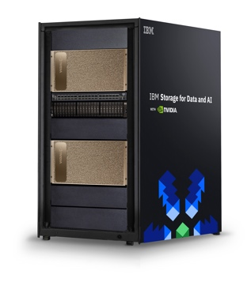




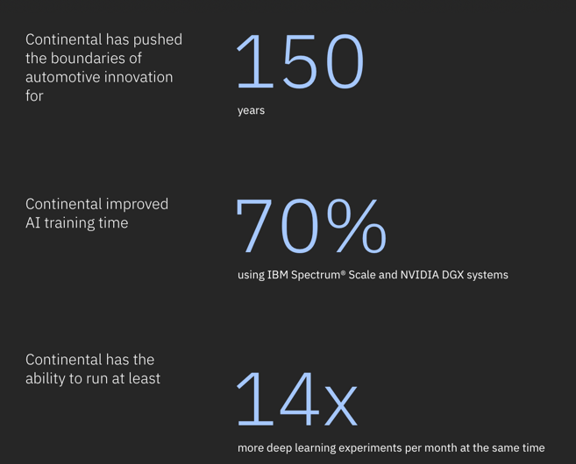
IBM Storage and NVIDIA
US DOE Summit & Sierra
Built in 2018
#2 and #3 fastest
supercomputers in the world
Summit: 27,648 Tesla GPUs
2.5 TB/s single stream IOR
2.6 M 32k file creates
16 GB/s r/w per node
IBM Storage &
NVIDIA Collaborations
IBM Data Science Pipeline 2018
  DGX-1 POD RA: 2018
  DGX-2 POD RA: 2019
  DGX-2H SuperPOD RA: 2019
  Red Hat OpenShift on DGX: 2020
  DGX A-100 2/4/8 RA: 2021
  GPU Direct to Storage (GDS) Beta Partner
NVIDIA Circe
Built in 2018 in 3 weeks
#61 Top 500 in 2018
36 NVIUDIA DGX2 nodes
Mellanox EDR
ESS GS4S 276 TB
NVIDIA DGX-2H SuperPOD
Built in 2019
#22 Top 500 in 2019
96 NVIUDIA DGX2 nodes
Mellanox EDR
ESS GS4S 0.5 PB
Public
Client Wins
  Continental
  Automotive
  ZF Automotive
  Amsterdam UNC
  Research Cloud
  Julich JEWELS
  ABCI, Tokyo
Notes:
This slide is self-explanatory.
Notes:
TB = Terabyte
PB = Petabyte
EDR = Extended data rate
GB/s = Gigabyte per second
TB/s = Terabyte per second
r/w = Read/write
M = Million
k = Thousand

Slide 8
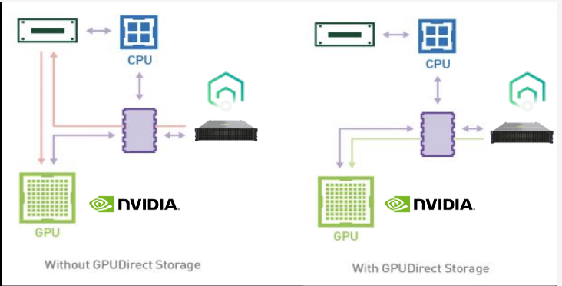
GPUDirect Storage
IBM Spectrum Scale 5.1.1 Tech Preview
GPUDirect (GDS) enables a NVIDIA developer to
Make a direct memory access (DMA)
between GPU memory and storage
Reduce latency, increase bandwidth, and lower CPU utilization by bypassing the CPU complex
Requires NVIDIA’s GDS SDK,
which is currently in Beta
Available for all IBM Spectrum Scale clients via Tech Preview, not production support
IBM Spectrum Scale provides multiple options accelerating I/O
Small file storage: Automatic enhancement for files up to 4 KB
LROC: Client-side data cache using local memory or fast storage.
Dynamic block sizing: Applied at run-time to align reads & writes.
POSIX locking: Lock sections of a large file for simultaneous work.
Prefetch tuning: Run time call to optimize I/O for an application..
Page Pools: Pinning CPU memory for faster data access.
RDMA: Storage-to-CPU memory. Avoids protocol overhead
NVIDIA GDS: Storage-to-GPU RDMA bypassing CPU memory.
Notes:
This slide is self-explanatory.
Notes:
KB = Kilobyte
LROC = Local read-only cache
RDMA = Remote Direct Memory Access
SDK = Software development kit
CPU = Central processing unit
GPU = Graphics processing unit

Slide 9
GPUDirect Storage
Tech Preview: IBM Spectrum Scale 5.1.1
Requires NVIDIA Beta Code v. 0.9+
GPU Direct (GDS) enables an explicit direct memory access (DMA) between GPU memory and storage when used in the application code.
GDS avoids having to copy data to/from CPU memory and then to/from GPU:
  GDS obviates the need for a ‘bounce buffer’ in the CPU’s memory.
  GDS increases bandwidth, decreases the latency, and reduces load on the CPU
NVIDIA Magnum IO
Family of I/O Optimizations for GPU accelerated data centers.
GPU Direct RDMA: Access peer node’s memory without copying to host memory
GPU Direct Storage: Transfer data to/from GPU directly from storage without involving CPU and CPU memory
GDS is support on InfiniBand
CUDA Toolkit
GDS will be in the CUDA toolkit
Development environment for GPU accelerated applications
Libraries, compilers, debuggers, optimizers, and tools
Leading GPU compute platform since 2006
GDS for Applications
Invoked using the CUDA Toolkit (cuFile) API
APIs must be explicitly called by the applications
Storage must be GDS enabled. If not, GDS call falls back to regular data movement.
Why it matters
AI, HPC, Analytics are data hungry and require a very high data throughput.
GPUs are starved by slow I/O (and NFS is particularly slow)
Currently: Beta Release with limited use case support.
Notes:
This slide is self-explanatory.
Links:
CUDA EULA: https://developer.nvidia.com/gpudirect-storage: “You may use a pre-release SDK at your own risk, understanding that pre-release SDKs are not intended for use in production or business-critical systems.“
Magnum IO: multi-GPU, multi-node input/output
Magnum IO: https://www.nvidia.com/en-us/data-center/magnum-io/
CUDA: https://developer.nvidia.com/cuda-toolkit
OpenACC: https://developer.nvidia.com/openacc
GPUdirect Storage: https://developer.nvidia.com/blog/gpudirect-storage/

Slide 10
Data throughputs theoretical peak
In real life:
Some applications will benefit from changing code to support GDS,
but not all.
IBM Spectrum Scale provides other optimizations that may be more effective and easier to implement.
Networking is often the limitation for large files.
IBM Spectrum Scale tuning or GDS will deliver 70% to 80% of theoretical throughput
100 Gb/s (EDR)
12.5 GB/s
200 Gb/s (HDR)
25 GB/s
GDS only improves the throughput of those mapped memory calls in the program, not all data transfers.
Beta results show significant improvement in throughput, latency, and CPU utilization.
As expected, results are network limited when sufficient storage is provided
Beta test results deliver 70% to 80% theoretical network bandwidth for storage throughput.
Relative benefit claims can vary significantly because some systems deliver poor baselines
  NFS gains most improvement (>2x) with GDS
  NFS baseline is > 30% slower than IBM Spectrum Scale
  IBM Spectrum Scale without GDS can also deliver 70% to 80% of theoretical network bandwidth for storage throughput with storage only optimizations.
GDS:
Greatly reduced CPU overhead
Increased I/O throughput
Lower latency
Incremental gains are dependent upon number of threads and baseline storage throughput
Always requires changing application code
Notes:
This slide is self-explanatory.
Notes:
GB/s = Gigabytes per second
Gb/s = Gigabits per second
CPU = Central processing unit
GPU = Graphics processing unit
Links:
GPU Memory Source: https://www.nvidia.com/en-us/data-center/a100/
Study of DGX-2 Systems Bandwidth and Latency: https://developer.nvidia.com/blog/gpudirect-storage/
16 GB/s PCIe gen3
64 GB/s PCIe gen4
126 GB/s PCIe gen5 (2022)
NDR 2022 = 400GB/s

Slide 11

IBM Spectrum Scale provides multiple I/O tuning options
Storage Side Optimizations
Developer Side Optimizations
Small File Optimization
Consolidate access for files under 4 KB.
RDMA
Storage-to-CPU memory. Avoids protocol overhead.
NVIDIA GPU Direct Storage
Storage-to-GPU RDMA bypassing CPU memory.
LROC (Local Read Only Cache)
Client-side data cache using local memory or fast storage.
Page Pools
Pinning CPU memory for faster data access.
Dynamic Block Sizing
Applied at run-time to speed writes and align reads.
Prefetch Tuning
Run time call to optimize for an application.
POSIX Locking
Lock sections of a large file for simultaneous work on different sections.
Toolbox by Maxicons from the Noun Project
Notes:
This slide is self-explanatory.

Slide 12
IBM sign-off
Notes:
Thank you!

